Slide 1

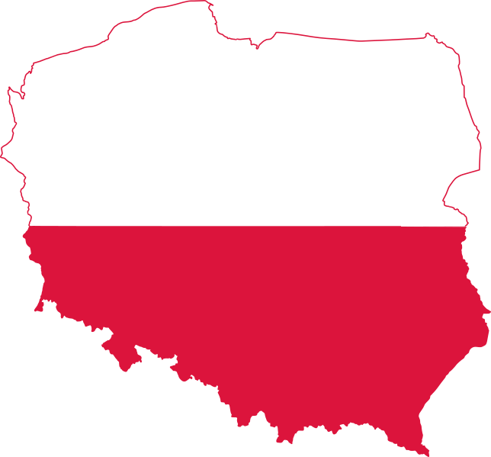
MBA(BA) Group 2
Aishwarya Singh - 20020845004
Mohit Tiwari - 20020845017
Rutwik V Jangam - 20020845024
Taksande Sandeep Ravindra - 20020845030
Country Risk Analysis
POLAND

Slide 2

Economic Profile
Poland is among the fastest-growing economies in the European Union.
Poland’s economic growth prospects is fueled by continuing low interest rates and the execution of European funds–related investments.
In the short-term, the main challenge is to mitigate the social and economic impact of the COVID-19 pandemic.
Poland’s relatively low level of indebtedness and solid macroeconomic and financial fundamentals give it the space to support economic growth amid the ongoing adverse shock.
Poland has the fiscal and monetary space to mitigate the adverse effects of lower global and domestic demand and shield its financially vulnerable populations, potentially leading to a quicker rebound in 2021 and 2022.
Since the 1990s, the World Bank has been one of the most prominent development institutions in Poland, providing a total of US$16 billion in loans and helping introduce a number of key policy reforms.
POLAND | 2019
Income Level | High Income
Region | Europe & Central Asia
Population, million | 38
GDP, current US$ billion | 628.2
GDP per capita, current US$ | 16,543
Life Expectancy at Birth, years (2017) | 77.9

Slide 3
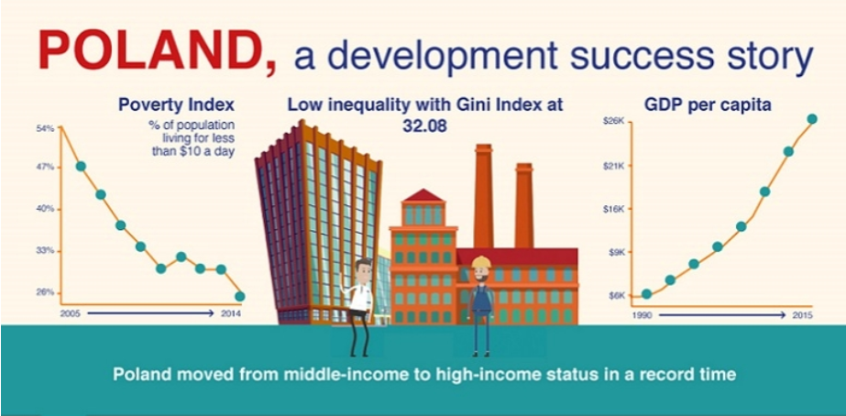
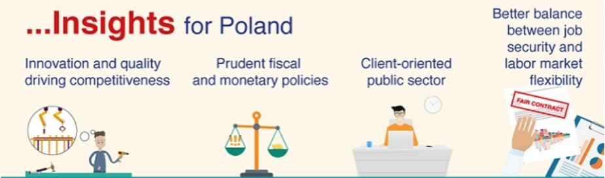
Economic Profile
The main medium-term challenge to sustained growth is a tightening labour supply exacerbated by an aging population.
The country has a tight labour market, and rising wages. Labour scarcity is an obstacle to expanding output.
Following several years of moderate dynamics, wage growth in Poland has recently picked up faster than labour productivity.
The increase in real unit labour costs occurred alongside an unprecedently-tight labour market.
The more subdued real unit labour costs dynamics compared with the pre-crisis period, despite the now-lower unemployment rate, may reflect the recent influx of foreign workers.

Slide 4
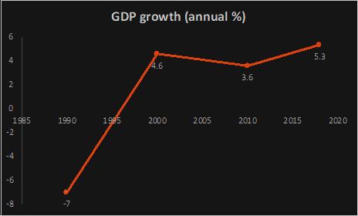
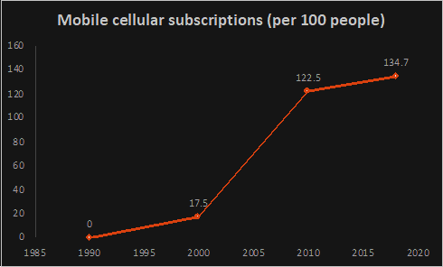
Economic Profile – Visualizations
 | Exports of goods and services (% of GDP) | Imports of goods and services (% of GDP)
2000 | 27 | 34
2010 | 40 | 42
2018 | 55 | 52
Agriculture, forestry, and fishing, value added is 2% of GDP.
Industry (including construction), value added is almost 29% of GDP consistently from many years.

Slide 5
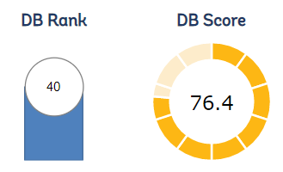
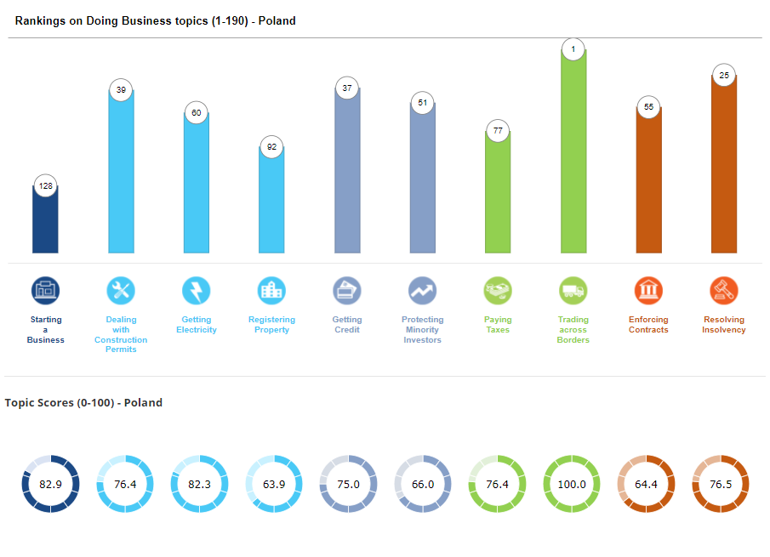
Ease of Doing Business in Poland
Poland comes under the region of OECD high income group with a GNI per capita of US$ 14,150. The ease of doing busines in this country can be measure by the doing business rankings which considers the business regulations and their enforcement in the country. Poland ranks 40 out of the 190 countries in terms of doing business with a DB (doing business) Score of 76.4 in 2020, although a drop from a DB score of 76.9 in the year 2019 and a drop of 7 positions in rank.

Slide 6
Ease of Doing Business – Individual Components
Considering the 10 indicators that constitute the doing business score, we get an overall idea of regulatory environment for doing a business. We shall now go through each of the indicators to asses Poland’s ease of doing business.
Starting a Business: Poland is ranked 128 out of the 190 countries with a DB score of 82.9 indicating that it is difficult to start a business when compared to other countries. The main hindrances being the complex procedure and the time taken for the registrations to complete. On the other hand, the positives include the lesser cost for the procedures and also a lesser Paid-in minimum capital. The benchmark for this indicator is set by New Zealand (Ranked 1).
Dealing with Construction Permits: Poland performs better here with a rank of 39 and a DB score of 76.4. The average metrics of Poland for procedures, time and cost are all below the average metrics for OECD high income countries indicating that there is an ease in dealing with construction permits. The highest ranked country for this indicator is Hong Kong SAR, China.
Getting Electricity: Poland is ranked 60 with a DB score of 82.3 with a decent rise from the previous year score of 81.4. This is due to the business reform that had been brough in the country. Poland made getting electricity faster by implementing a new customer service platform that allows the utility to better track applications for new commercial connections. The average metrics of Poland for procedures, time and cost are all below the average metrics for OECD high income countries indicating that there is an ease in getting electricity. The highest ranked country for this indicator is United Arab Emirates.
Registering Property: Poland is ranked 92 with a DB score of 63.9 with a substantial drop from the previous score of 70.5. This is due to the change in reform that had been made. Poland made transferring property more difficult by increasing the time needed to apply for registration at the Land and Mortgage Registry. Though the cost is substantially lower, the time taken to register a property (135) is significantly higher when compared to the OECD high income countries (23.6). The highest ranked country for this indicator is Qatar.

Slide 7
Ease of Doing Business – Individual Components
Getting Credit: Poland is ranked 37 with a DB score of 75. This indicator talks about credit information sharing and also the legal rights of borrowers and lenders. Poland’s strength of legal rights index is medium (7) indicating laws that are satisfactorily designed to expand access to credit. Poland also has the highest depth of credit information index that measures rules and practices affecting the coverage, scope and accessibility of credit information available through a credit bureau. The highest ranked countries include New Zealand, Azerbaijan and Brunei.
Protecting Minority Investors: Poland is ranked 51 with a DB score of 66. This indicator tells us about investor protection. Though Poland has a good extent of disclosure index, ease of shareholder suits index and extent of corporate transparency index. It has a very low extent of director liability index that indicates that board members can seldom be held liable for harm caused by related-party transactions. Poland also has a good extent f shareholder rights index that measure the roe of shareholders in key corporate decisions. The nest ranked country for this indicator is Kenya.
Paying Taxes: Poland ranks 77 with a DB score of 76.4. The number of tax payments made per year stands at 7 which is lower than that of the OECD high income countries. The major hinderance here is the time it takes to prepare, file and pay taxes; it is more than double of the average time take by the OECD high income countries. The total tax rate though is decent at 40.8% of the profit. The best ranked country for this indicator is Bahrain.
Trading Across Borders: This is one indicator in which Poland shines due to the Economic Union it is apart off. Poland is ranked 1 with a DB score of 100. As Poland is a part of the European Union, the time and cost associated with three sets of procedures: documentary compliance, border compliance and domestic transport – within the overall process of exporting or importing a shipment of goods are practically 0 in terms of cost and the bare minimum in terms of the time. Almost all the European Union countries are ranked as the best for this indicator.
Enforcing Contracts: Poland ranks 55 with a DB score of 64.4. A major hinderance in the ease of enforcing contracts can be the time taken to resolve a dispute in court, which is 685 days this 5 times higher than the best performing nation i.e., Singapore. The cost as well is on the higher end with a decent enough quality of judicial process.
Resolving Insolvency: Poland ranks a good 25 out of the 190 countries with a DB score of 76.5. Poland has a decent recovery rate although below the recovery rates of OCD high income countries. The time and cost required to resolve the bankruptcies is however almost twice that of the OECD high income countries. The strength of the insolvency framework is good that tells us about the existing bankruptcy law. The best country for this indicator is Finland.

Slide 8
What makes it Easier/Harder to do business ?
What makes it harder(bottlenecks) to do business in Poland?
Recent disconnect of Poland with the European Union if further deteriorated, can completely shift the ease of business conditions in the country.
Registering a Property (Change in 2020,2019) – increase in the time needed to apply for registration and highly complex procedures.
Paying Taxes (Change in 2019) – complicating procedures of monthly tax returns, introducing new reporting methodologies.
Starting a Business – Time taken for an individual to register a business and complex procedures.
Time taken to resolve commercial disputes in courts.
Time taken and not very high recovery rate from insolvent firms.
What makes it easier to do business in Poland?
Getting Electricity (Reform in 2020) – utility to better track new commercial connections.
Enforcing Contracts (Reform in 2019) – automated systems to assign cases to judges randomly.
Dealing with Construction Permits (Reform in 2017) – streamlining the process of obtaining permits.
Trading Across Borders – advantage of being part of the European Union.
Decent in protecting legal rights of Minority Investors, Shareholders, Borrowers and Lenders.
Note: The bottlenecks can be taken with a pinch of salt as most of the indicators that make it hard to do business in Poland are relatively better when compared to other countries whose indicators are even in a higher lower rank. These indicators can be taken into count when you have distinguishable alternative countries available.

Slide 9
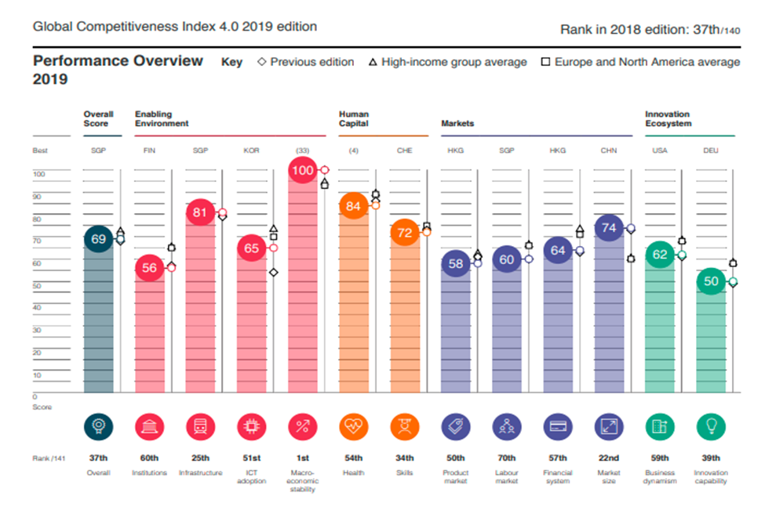
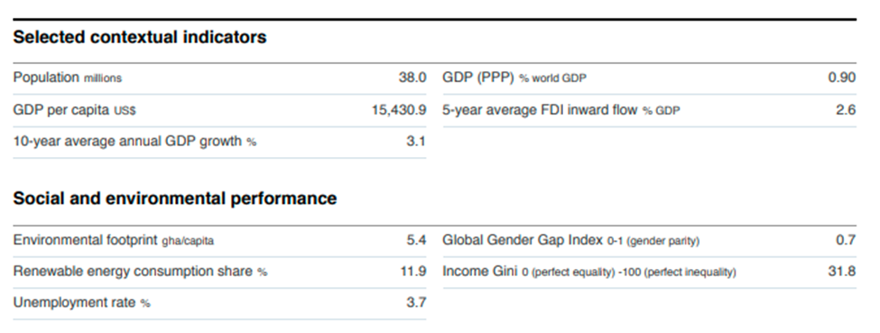
Global Competitive Index
Three stages of country Development:
a) Factor Driven Stage b) Efficiency Driven Stage c) Innovation Driven Stage
Index Component (Pillars) | Score | Rank / 141 | Best Performer
Institutions | 56.4 (D) | 60 | Finland
Infrastructure | 81.2 (I) | 25 | Singapore
ICT Adoption | 65.4 (I) | 51 | Korea Republic
Macroeconomic Stability | 100 | 1 | Multiple
Health | 83.8 (D) | 54 | Multiple

Slide 10
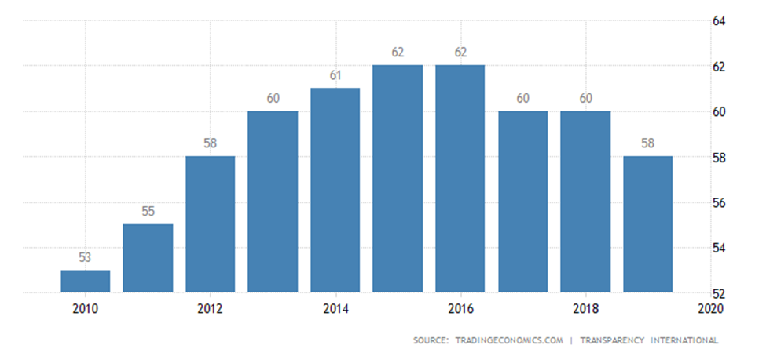
Corruption Index
Score as per Corruption Perception Index: 58 (Rank 41)
2018 Score: 60
Denmark and New Zealand – Least Corrupt Countries with a score of 87
Government is trying to systematically to subdue the judiciary
60 judges have faced various kinds of repression since 2017 when PiS established the disciplinary chamber
The country slipped from 29th to 41st in Transparency International’s Corruption Index

Slide 11
Political and Civil freedom
Press freedom Index: Noticeable Problems
• Discrepancy between its legal framework and reality
• Current media law poses a threat to the future development of media freedom
• Public opinions on press freedom is polarized
• Reason, ideological differences existing in the post- communist Poland
Democracy Index: Flawed Democracy
• Poland has fallen in the annual index of democracy, according to Freedom House
• Now classified as “Semi- Consolidated” democracy
• Became second EU member state to lose its full democratic status
• Started to decline in 2012, accelerated when Law and Justice party came into existence
• Lowest ever position of 62nd following 5 consecutive years of decline
Freedom in the world: Free
• Total Score: 84/100
• Political Rights score : 35/40
• Civil Liberties Score: 49/60
Index of Economic Freedom: Moderately Free
• Score 69.1, ranked 46
• Overall score increased by 1.3
• Ranked 25th among 45 countries in the Europe region
• Economy have been climbing moderately free for more than a decade
• Government spending has amounted to 41.3% of the country’s GDP over the past 3 years

Slide 12
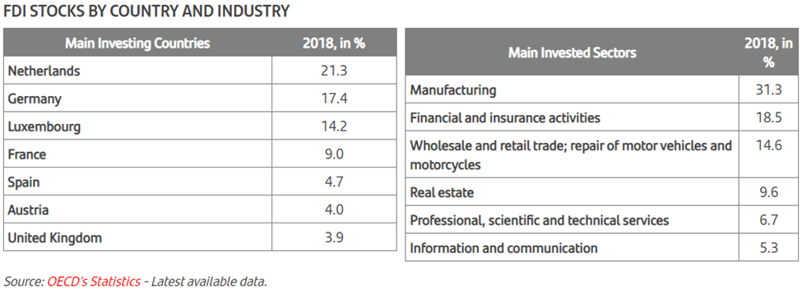
Are foreign investors investing in Poland?
Poland in the current global business outlook is one of the most attractive countries in Europe for foreign investments. As per the UNCTAD’s World Investment Report 2020, Poland received FDI inflows of USD 13.2 Billion in 2020, slightly less from inflows of USD 13.9 Billion in 2019. The FDI stock currently stands at USD 236.5 Billion. There was also an increase in the number of greenfield investments form 445 in 2018 to 448 in 2019. Although the increase in number is small the value of the greenfield investments saw a jump from USD 18.2 Billion in 2018 to USD 24.4 Billion in 2019.

Slide 13
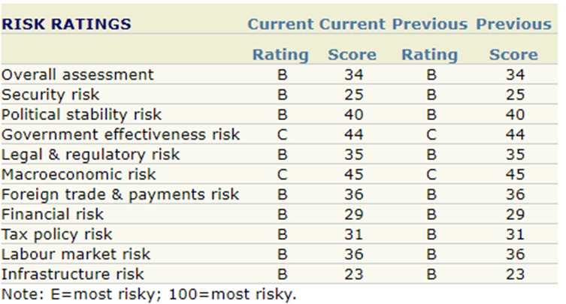
Risk Ratings
Poland has lower risk rating for majority of the pillars.
Below are the factors with more associated risks-
Macroeconomic risks-
In 2020, Poland is expected to experience a further deceleration of growth, after a slowdown perceived in 2019.
An increase of inflation and will make wage growth less robust in real terms
Prices are likely to exceed the central bank’s inflation target in the first quarter of 2020, being fuelled by further growth of food prices and a possible increase of electricity prices.
Labour shortages are likely to ease, facing lower demand expectations.
Government Effective risks-
Political and policy uncertainties
Non-diversified regional external trade structure

Slide 14
Is it the right time to invest in Poland?
YES, below are the factors to prove the same-
STEADILY GROWING ECONOMY
Constant GDP growth since 1991 – unmatched by any other EU country
Fastest per capita GDP growth in Central Europe, 1995-2016
The most stable economy in Central Europe
POLAND'S COMPETITIVE ADVANTAGES
Beneficial ratio of worker productivity to employment costs
Exceptional quality of education, especially in science, technology and IT
Large percentage of the population speaks English
UNTAPPED GROWTH POTENTIAL
Production capital per worker is just 1/4-1/3 that of highly developed countries
Low professional activity: 40% of Polish women do not work professionally and are not seeking jobs
Big potential for improving the quality of regulations and developing alternative sources of financing, e.g. PPP
FOREIGN DIRECT INVESMTENT
Total value of FDI is 712 billion zlotys, equal to 45% of Poland's GDP
Almost 230 billion zlotys of FDI went into manufacturing, Germany is the leading investor in Poland

Slide 15
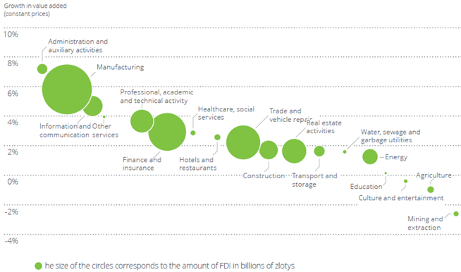
Significant sectors to invest
Manufacturing
Poland is opening the door to further productivity growth and job creation for highly qualified workers ,by offering competitive conditions for the manufacturing industry.
The automotive sector, with approximately 900 companies and 10% of the country's total manufacturing output Tenneco, Valeo, Delphi etc opened R&D centres there.
According to the most recent data, 125.3 billion zlotys were invested in SEZs
Their $1.11 trillion economy is focused on manufacturing machinery and transport equipment.
Business services (BPO/SSC), IT and telecommunications
There are around 1,000 BPO/SSC centres in Polish cities (676 are foreign-owned), employing 200,000 workers.
In recent years the sector has grown by 20% annually ABSL forecasts that by 2020 the total number of employees in the services sector will increase to 300,000.
Due to growing employment and office lease costs in the biggest cities (Warsaw,Kraków, Wrocław), many BPO/SSC centres are being opened in smaller cities too.

Slide 16
Bibliography
https://www.worldbank.org/en/country/poland/overview
https://data.worldbank.org/country/poland
https://databank.worldbank.org/views/reports/reportwidget.aspx?Report_Name=CountryProfile&Id=b450fd57&tbar=y&dd=y&inf=n&zm=n&country=POL
https://www.worldbank.org/en/news/infographic/2017/03/21/poland-development-success-story
https://www.doingbusiness.org/en/data/exploreeconomies/poland#DB_sb
http://www.economy.ge/uploads/ek_ciprebshi/reitingebi/reitingebi_eng/gci.pdf
https://notesfrompoland.com/2020/05/06/poland-no-longer-rated-as-full-democracy-in-new-freedom-house-index/
https://en.wikipedia.org/wiki/Democracy_Index
http://www.cfom.org.uk/wp-content/uploads/2017/08/Student-Comp-2016-17-Final-Poland-case-study.pdf
https://freedomhouse.org/country/poland/freedom-world/2020
https://tradingeconomics.com/poland/corruption-index
https://www.economist.com/europe/2020/03/22/as-polands-government-punishes-judges-corruption-is-rising
https://santandertrade.com/en/portal/establish-overseas/poland/foreign-investment?url_de_la_page=%2Fen%2Fportal%2Festablish-overseas%2Fpoland%2Fforeign-investment&&actualiser_id_banque=oui&id_banque=0&memoriser_choix=memoriser
https://www.coface.com/Economic-Studies-and-Country-Risks/Poland
https://www.abc-amega.com/articles/country-risk-poland/

Slide 17
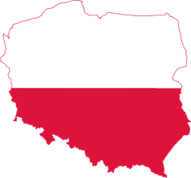
Dziękuję Ci Thank you

